Slide 1

E-INVOICE & E-WAY BILL ADDON SAP BUSINESS ONE
Authored By :- Remant Mishra

Slide 2

INTRODUCTION
Overview:
Reedham IT Solutions has developed a robust E-Invoice and E-Way Bill add-on specifically designed to integrate seamlessly with SAP Business One. This add-on is engineered to simplify and automate the process of electronic invoicing and e-way bill generation, ensuring compliance with local and international regulations.
Authored By :- Remant Mishra

Slide 3
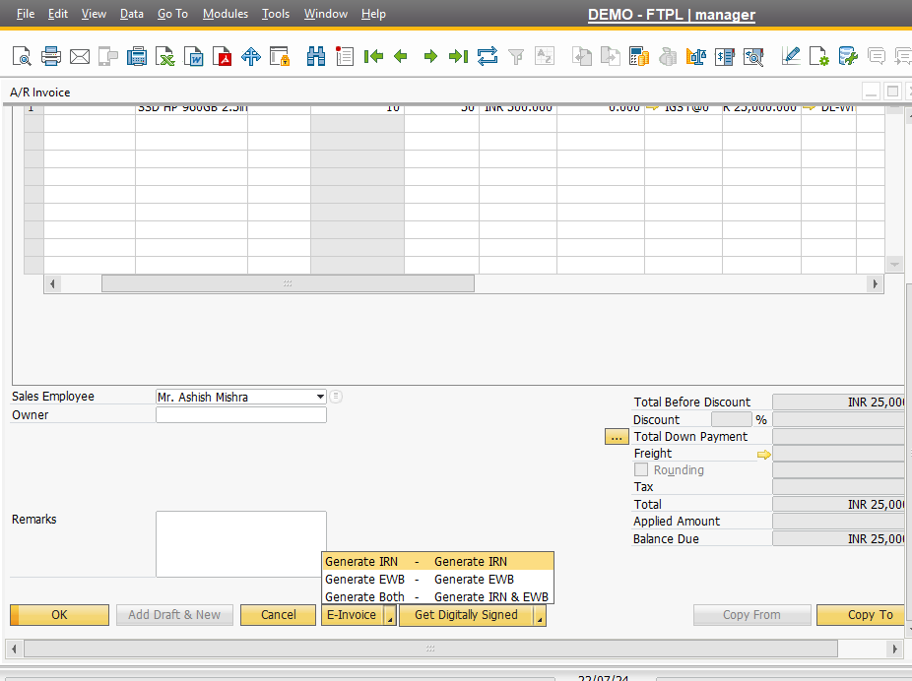
Main Screen – E-Invoice Addon
Silent Features
A Button Combo Named E-Invoice will be appeared on the marketing Documents.
This will be a button combo containing Three options
a) GENERATE IRN
B) GENERATE EWB
C) GENERATE BOTH
.
Once User click on any option it will generate the E-invoice , E-way bill or both.
For E-way bill You need to fill certain mandatory fields in UDF that is necessary to generate Ewb.
Authored By :- Remant Mishra

Slide 4
E-Invoice– Setup With GSP
Silent Features
You can setup hassle free integration with GSP.
You can mange multiple GST with GSP
You can Define Custom Transported ID For E-way bill generation.
Authored By :- Remant Mishra

Slide 5
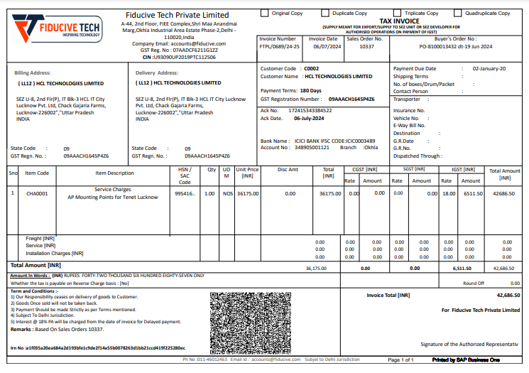
E-INVOICE COPY
Authored By :- Remant Mishra

Slide 6


Thank You!
SAP is Backbone ! REEDHAM IT SOLUTION MAKES IT POSSIBLE
Phone : +91 9811596533
E-Mail : info@reedhamitsolution.com
Website: reedhamitsolution.com
Head Office: B-125, DDA SHED, OKHLA PHASE-1, NEW DELHI- 110020

